Slide 1
Chapter 5 Pattern-Oriented Software Development
5.1 What is a Pattern?
5.2 Architectural Patterns
5.3 Design Patterns

Slide 2
5.1.1 Pattern Definitions
C. Alexander: a pattern is as “a solution to a problem in a context” ^{(*)}:
“Each pattern describes a problem which occurs over and over again in our environment and then describes the core of the solution to that problem, in such a way that you can (re)use this solution a million times over, without ever doing it the same way twice.” (Alexander, C., Ishikawa, S., Silverstein, M., A Pattern Language, Oxford University Press, New York, 1977)
UML: A pattern provides a common solution to a common problem in some context. Complex systems have common patterns.
Buschmann et al.: A pattern addresses a recurring problem that arises in specific design situations, and presents a solution to it.
(*) Adapted from [Shalloway et al. 2005].

Slide 3
5.1.3 Pattern Schema ^{(*)}
A pattern has four essential elements:
Name: all patterns have a unique name that identifies them.
Intent: the purpose of the pattern.
Problem: the problem that the pattern is trying to solve.
Solution: the solution that the pattern provides to the problem in the context in which it shows up.
Consequences: the results and trade-offs of applying the pattern
(*) This is not a standard pattern schema. Readers may refer to [GoF 1995] or [Grand 1998].
Notes:
Intent
Synopsis
Motivation
Applicability
Structure
Context/Problem
solution
Participants
Collaborations
Consequences
Known Uses
Related Patterns
examples
Scenario
Implementation:

Slide 4
5.2 Architecture Patterns [Buschman et al. 1996]
5.2.1 Pipes and Filters
5.2.2 Model-View-Controller
5.2.3 Layers
5.2.4 Broker
Exercises

Slide 5
5.2.1 Pipes and Filters
Intent: Processing large amount of data streams.
Problem
To build a system that must process or transform a stream of input data. The system has to be built by several developers, the global system task decomposes obviously into several processing stages, and the requirements are likely to change.
Notes:
[Buschman et al.]

Slide 6
Pipes and Filters (cont’d)
Solution
Provide a system structure that process a stream of data. Each processing step is encapsulated in a filter component. Data is passed through pipes between adjacent filters.
Divide the task of a system into several sequential processing steps. These steps are connected by the data flow through them.
Each processing step is implemented by a filter component, which consumes and delivers data incrementally.
The input to the system is provided by a data source.
The output flows into a data sink.
The data source, the filters and the data sink are connected sequentially by pipes.
The sequence of filters combined by pipes is called a processing pipeline.

Slide 7
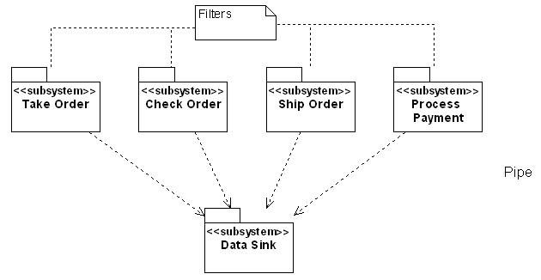
Pipes and Filters (cont’d)
Example 1: An Order Processing System
Data Sources

Slide 8
Pipes and Filters (cont’d)
Scenario.
“Take Order” does its function, then put a stack of orders into data source/sink.
“Check Order” checks the status of the order.
“Ship Order” picks up a stack of orders, fill, and ship them.
“Process Payment” picks up any payments from the data source/sink and process them.
Each subsystem does its job completely independent of the rest subsystems

Slide 9
Pipes and Filters (cont’d)
Consequences.
Benefits:
No intermediate files necessary
Flexibility by filter change and recombination
Reuse of filter components
Rapid prototyping of pipelines
Parallel processing
Deficiencies:
Sharing state information is expensive or inflexible.

Slide 10
In Class Exercise
A telephone survey center does its surveys through the following procedures
Generate a list of phone numbers by stratified random sampling
The computer picks one phone number for a operator, calls out, and let the operator input the response through the user interface, until the required number of response are collected.
Export all responses to a text file, and fed into SPSS for statistical analysis.
Extract the results from SPSS and write the report
Please design a proper architecture for the survey support system

Slide 11
5.2.2 Model-View-Controller (MVC)
Intent: Help separate the user interface from other parts of the system.
Problem
To design an interactive application with a flexible human-computer interface to support increased reuse of domain objects, and minimize the impact of changes in the interface upon the domain objects.
The same information is presented differently in different windows, e.g. in a bar or pie chart.
The display and behavior of the application must reflect data manipulations immediately.
Change to the user interface should be easy, even at run-time
Supporting different “look and feel” standards or porting the user interface should not affect code in the core of the application.

Slide 12
Model-View-Controller (cont’d)
Solution.
Divide an interactive application into three components:
Model components: responsible for maintaining domain knowledge.
View components: responsible for displaying the domain knowledge to the user.
Controller components: responsible for managing the sequence of interaction with the user.
Changes in their state of model components propagated to the view components via the change-propagation mechanism which is the only link between the model components and the view and controller components.
Change-propagation mechanism ensures consistency between user interface (view) and model.

Slide 13
Model-View-Controller (cont’d)
Detailed explanation of model, view, and controller components.
A Model
encapsulates core data and functionality, independent of specific output representations or input behavior.
registers the dependent view and controller.
does not have direct coupling or visibility to the view (window classes), so application data and functionality is maintained in the model (domain classes), not the view.

Slide 14
Model-View-Controller (cont’d)
A View
displays information to the user.
implements the update procedure.
retrieves data from the model.
creates and initializes its associated controller.
A Controller
receives input (usually via activation of mouse buttons or keyboard).
translates events to service requests for the model or display requests for the view.
implements the update procedure if required.

Slide 15
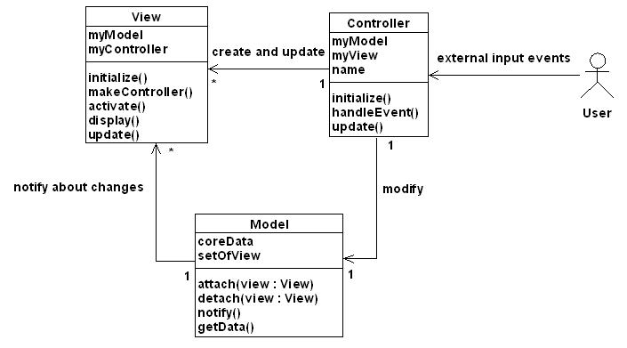
Model-View-Controller (cont’d)
Notes:
Scenario
The controller accepts user input in its event handling procedure, interprets the event, and activates a service procedure of the model
The model performs the requested service. This results in a change to its internal data
The model notifies all views and controllers registered with the change-propagation mechanism of the change by calling their update procedures
Each view requests the changed data from the model and redisplays itself on the screen.
Each registered controller retrieves data from the model to enable or disable certain user functions
The original controller regains control and returns from its event handling procedure.

Slide 16
Model-View-Controller (cont’d)
Consequences.
Benefits:
The three components can be independently designed.
Quite easy to change the UI by changing the view, the control, or both.
Increasing cohesion an reducing coupling because of minimal communication channels between the three components.
To port an MVC application to a new platform does not affect the functional core of the application.
Deficiencies:
A strict separation of the three components is sometimes too rigid.
The update mechanism of views is inefficient due to lack of information.

Slide 17
In-Class Exercise
Members of a club want to vote for a new club logo. They need a system letting the members to browse the candidate logos then give their votes to one of the logos.
Please use the MVC pattern to design the architecture.

Slide 18
Question
Can we use the “Pipes and Filters” pattern and the “MVC” pattern together?

Slide 19
5.2.3 Layers
Intent: Decomposing a large system.
Problem
Many parts of the system are highly coupled.
Application logic is intertwined with the user interface.
It is difficult to divide the work along clear boundaries for different developers.
It is hard to scale up the system to use new technologies.
Business logic is intertwined with more application specific logic, so cannot be reused
Notes:
[Buschmann et al.. 96]

Slide 20
Layers (cont’d)
Solution
Structure your system into an appropriate number of discrete layers with clean separation of concerns such as the lower layers are low-level and general services, and the higher layers are more application specific.

Slide 21
Layers (cont’d)
Client
uses
Layer N
Highest level of abstraction
Layer N-1
System decomposition
Layer 1
Lowest level of abstraction

Slide 22
Layers (cont’d)
Consequences.
The separate layers can be independently designed.
A layer with well-defined and documented interface can be reused in multiple contexts.
Well-designed lower layers do not know about the higher layers, i.e., reduce coupling.
Individual layer implementation can be replaced by semantically equivalent implementation without too great an effort [Buschmann et al. 1996].

Slide 23
Layers (cont’d)
Example: Information Systems
Two-layer architecture: Client-Server system
Three-Layer (three-tier) architecture
Presentation: windows, reports, etc.
Application logic: tasks and rules that govern the process
Domain objects: classes representing domain concepts
Services: database interaction, reporting,
communications, security, etc.
Storage: persistent storage mechanism

Slide 24
Layers (cont’d)
Four-layer architecture
Presentation tier: responsible for user interface only, such as GUI
Application logic tier: responsible for all accesses to the domain tier; converting the underlying domain types into these types and interpreting any updates requested by the presentation, such as a series of façades
Domain tier: the semantics (rules) of the enterprise
Data source tier: databases

Slide 25
Layers (cont’d)
Example: Point of Sale (POS)
Presentation
Application logic/
Domain objects
Services
Storage
POS Applet
Payment
Sale
DB IF
RG
Database

Slide 26
In-Class Exercise
An international wholesaler wants to integrate the various production systems of its suppliers that the suppliers can acquire the sales and inventory information from the wholesaler, and plan their production accordingly.
The suppliers’ systems are developed with different software and different databases, and linked with different proprietary networks
What architecture would you recommend for the integration system?

Slide 27
5.2.4 Broker
Intent: To distribute aspects of the software system transparently to different nodes.
Problem
An service provider provides various decoupled services to remote service requests in distributed locations. But the clients may not know location of the servers they want to access.

Slide 28
Broker (cont’d)
Solution
Introduce a broker component to achieve better decoupling of clients and servers.
By using the Broker pattern, an application can access distributed services simply by sending message calls to the appropriate object, instead of focusing on low-level inter-process communication.
The Broker architecture is flexible, in that it allows dynamic change, addition, deletion, and relocation of objects.
The Broker pattern reduces the complexity involved in developing distributed applications.

Slide 29
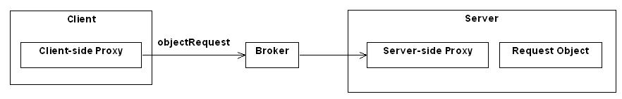
Broker (cont’d)

Slide 30
Broker (cont’d)
Consequences.
The remote objects can be independently designed.
The remote objects designed can be reused by other systems.
The broker objects can be updated as required, or the proxy can be redirected to communicate with a different remote object.
You can write client for new platforms and remote objects on other platform while still accessing brokers.

Slide 31
Broker (cont’d)
Example: Object Request Broker
Interface
Repository
Client
Dynamic
invocation
Client
IDL Stubs
ORB
interface
LAN
Server
object
Client
IDL Stubs
ORB
interface
Interface
Repository
Notes:
IDL: interface definition language

Slide 32
In Class Exercise
Discuss how the layer pattern and the broker pattern can be used for a “cloud computing” based system.

Slide 33
Exercises
Present three examples of applications for each of the architecture patterns.
Design ATM System
Select three kinds of architecture patterns.
Complete the Use case Model, Class Model (Package), Interaction Model
Discuss the advantages and disadvantages.

Slide 34
5.3 Design Patterns
5.3.1 Why Need Design Patterns?
5.3.2 Types of Design Patterns
5.3.3 Creational Patterns
5.3.4 Structural Patterns
5.3.5 Behavioral Patterns
5.3.6 Compound Design Patterns
Exercises

Slide 35
5.3.1 Why Need Design Patterns?
Benefits for using design patterns. [Carey et al. 2000]
help designers think about applications in ways they might not have previously considered.
can be thought of as providing a higher-level language for designers to work with.
help designers create flexible solutions, capture the essence of key business problems in a more abstract way, deal with the possible variations in the problem without necessarily having to implement them.
help designers isolate changes to a small subset of the objects in the application for software maintainability.
become the building blocks for design and construction.

Slide 36
Why Need Design Patterns? (cont’d)
So, we need design patterns because design patterns help with reuse and communication, and give a higher perspective on analysis and design [Shalloway et al. 2005]:
Reuse: By reusing already established design, we can start the problems by learning from the experience of others. We need not invent solution for commonly recurring problems.
Communication: For a teamwork, communication requires a common base of vocabulary and the common viewpoint of the problems. Design patterns provide a common point of reference during the analysis and design phase of a project.
Higher perspective: Design patterns give us a higher-level of perspective on the problem and on the process of design. This free us from dealing with the details too early.

Slide 37
5.3.2 Types of Design Patterns
According to [GoF 1995], design patterns are catalogued in the following. Readers do not need mind which pattern belongs to which design pattern catalog.
Creational patterns: create or instantiate objects: Factory Method, Abstract Factory, Singleton.
Structural patterns: bring together existing objects: Proxy, Composite, Adapter, Bridge, Façade, Decorator.
Behavioral patterns: give a way to manifest flexible behavior: Observer, Chain of Responsibility, Command, Template Method.

Slide 38
Types of Design Patterns (cont’d)
Though patterns are useful, they are only templates, that is, one cannot simply select a pattern and transmogrify it into code.
Note: The design patterns presented in this chapter are drawn from [GoF 1995] that presents 23 patterns useful during object design. In practice, perhaps approximately 15 of these 23 patterns are frequently used. We, therefore, only present these 13 frequently used patterns in this chapter. Readers may be referred to [GoF 1995] or [Grand 1998] to learn more design patterns.

Slide 39
5.3.3 Creational Patterns
Abstract Factory Pattern
Factory Method Pattern
Singleton Pattern

Slide 40
Abstract Factory
Intent.
To have families or set of objects for particular clients.
Problem.
How to create families of related or dependent objects that implement a common interface.
Solution.
Define a factory interface (i.e., the abstract factory).
Define a concrete factory class for each family of things to be created.
Define an abstract class that specifies which objects are to be made, if any.

Slide 41
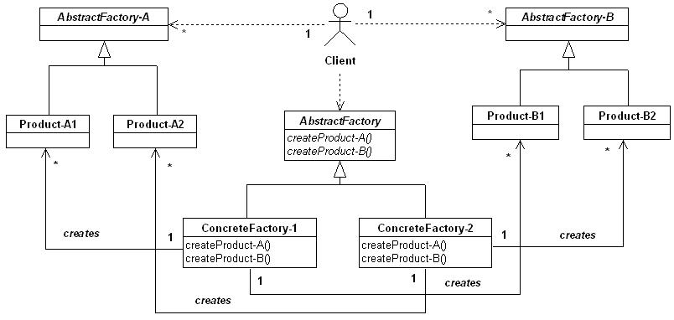
Abstract Factory (cont’d)
Note: This figure is redrawn on the basis of [Shalloway et al. 2005].

Slide 42
Abstract Factory (cont’d)
The family of things are Product-A1, Product-B1, Product-A2, and Product-B2 which are created by ConcreteFactory-1 and ConcreteFactory-2, respectively.
Abstract Factory is the interface for creating each member of the family of things.
The client object does not know which particular factory it uses because it only knows that it has an AbstractFactory object
Notes:
Note
A classic application of AbstractFactory: If your system needs to support multiple look-and-feel user interfaces, such as Motif window or PM window. You tell the factory that you want your program to look like PM window, and it returns a PM widget factory that returns PM window-like objects. When you request specific objects, such as scroll bar, the PM widget factory returns PM scroll bar.

Slide 43
Abstract Factory (cont’d)
Consequences.
The pattern isolates the clients from implementation classes.
Changing the concrete factory an application uses is easy, because the class of a concrete factory appears only once in an application.
An application uses objects from only one family at a time.
Extending abstract factories to produce new kinds of products is difficult.

Slide 44
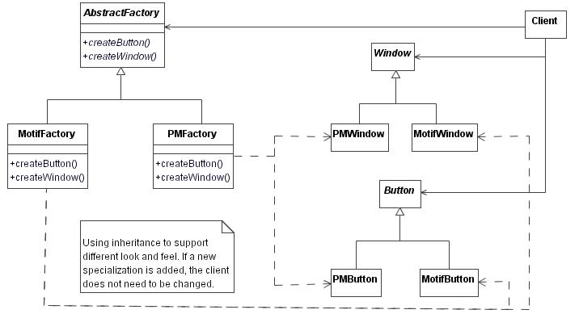
Abstract Factory (cont’d)
Example: A user interface toolkit ^{(*)}.
(*) [GoF 1995].

Slide 45
Factory Method
Intent.
Define an interface for creating an object, but let subclasses decide which class to instantiate. Factory Method lets a class defer instantiation to subclasses [GoF 1995].
Problem.
A class needs to instantiate a derivation of another class, but doesn’t know which one.
Solution.
A derived class makes the decision on which class to instantiate and the rules to instantiate it.

Slide 46
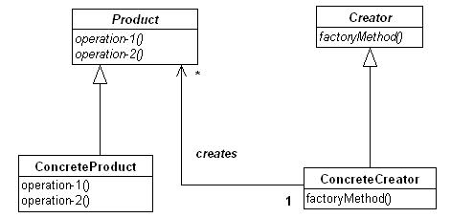
Factory Method (cont’d)

Slide 47
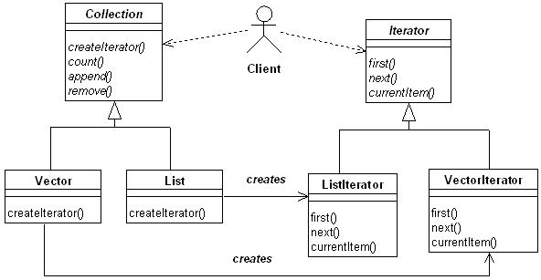
Factory Method (cont’d)
Consequences.
The set of product classes that can be instantiated (ConcreteProduct) may change dynamically.
Example: Java Iterator

Slide 48
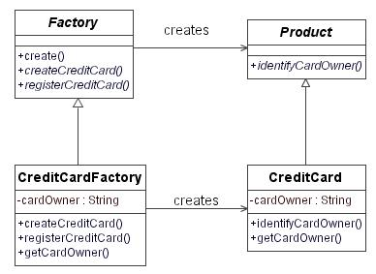
Factory Method (cont’d)
A bank wants to promote its credit card. A Factory Method handles the creation of credit cards.
Note:

Slide 49
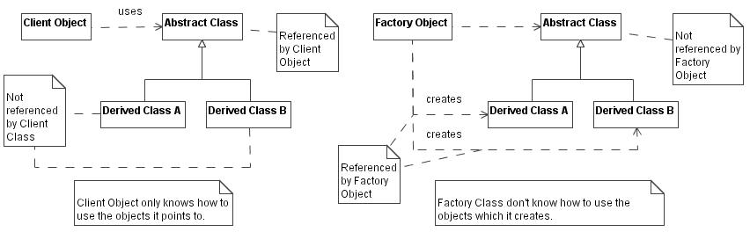
Factory Method (cont’d)
The perspectives of the “using object” and the “creating object”.
Objects should either use other objects or create other objects, but never both [Shalloway et al. 2005].
Note: Figures are extracted from [Shalloway et al. 2005], pp.352.

Slide 50
Singleton
Intent.
Ensure a class that only one instance is created. All objects that use an instance of the class use the same instance.
Problem.
Several different client objects need to refer to the same thing, and ensure no more than one of them.
Solution.
Define a static method of the class that returns the singleton.

Slide 51
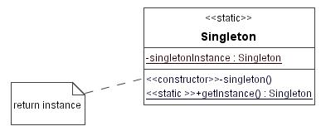
Singleton (cont’d)
Consequences.
Clients need not concern themselves whether an instance of the Singleton exists. This can be controlled from within the Singleton.
singletonInstance is a class scope attribute, and getInstance () is a class scope operation.

Slide 52
Singleton (cont’d)
An example of the e-commerce system.
abstract public class Tax {
static private Tax tax;
protected Tax ( ) { };
abstract double calcTax (double qty, double price);
public static Tax getInstance ( ) {
tax = Taiwan.getInstance ( );
return tax;
}
}
public class TaiwanTax extends Tax {
private static TaiwanTax tax;
private TaiwanTax ( ) { };
public static Tax getInstance ( ) {
if (tax = = null) tax = new TaiwanTax( );
return tax;
}
}
/*getInstance returns the singleton, the only instance tax.
*/

Slide 53
5.3.4 Structural Patterns
Façade
Adapter
Bridge
Decorator
Composition
Proxy

Slide 54
Façade
Intent.
Provide a unified interface (called façade) to a set of interfaces in an existing subsystem.
Problem.
You need to use only a subset of a complex system. Or you need to interact with the subsystem in a particular way. What to do?
Solution.
Define a single point of contact to the subsystem, a façade object that wraps the subsystem. This façade object (single unified interface) is responsible for collaborating with the subsystem components.

Slide 55
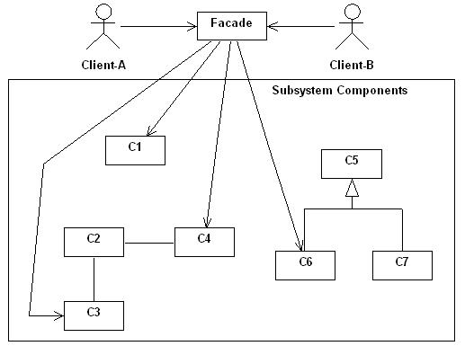
Façade (cont’d)

Slide 56
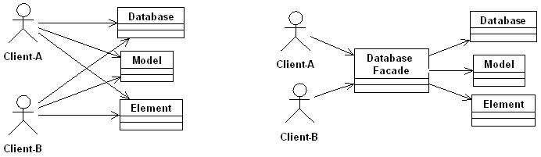
Façade (cont’d)
Consequences.
Clients need not to know about any of the classes behind the façade.
Façade can be used to reduce the number objects that a client must deal with.
Example.

Slide 57
Adapter
Intent.
To resolve incompatible interfaces, or provide a stable interface to similar components to be reused but with different interfaces.
Problem.
An existing class or a general-purpose class, and it is inappropriate for it to implement an interface for a specialized purpose. You may modify the class to fit your purpose, but you don’t have the source code for the class. What to do?

Slide 58
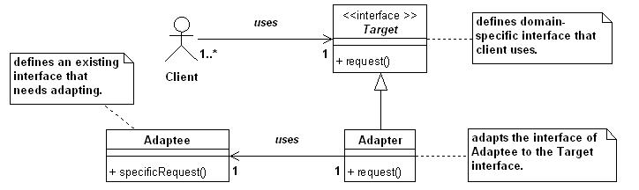
Adapter (cont’d)
Solution.
The Adapter provides a wrapper with the desired interface that a client uses.

Slide 59
Adapter (cont’d)
Consequences.
The Adapter pattern allows for preexisting or general-purpose objects to fit into new class structure without being limited by their interfaces.
Note: There are actually two types of Adapter patterns:
Class Adapter pattern: uses multiple inheritance to adapt one interface to another.
Object Adapter pattern: relies on one object (the adapting object) containing another (the adapted object)

Slide 60
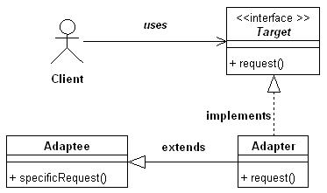
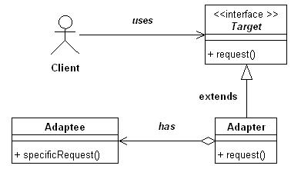
Adapter (cont’d)
Class Adapter pattern.
Object Adapter pattern.

Slide 61
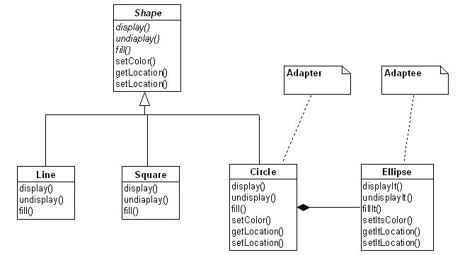
Adapter (cont’d)
Example.

Slide 62
Adapter (cont’d)
Implementing the Adapter pattern in Java.
class Circle extends Shape {
…..
private Ellipse myEllipse;
…..
public Circle ( ) {
myEllipse = new Ellipse;
}
void public display ( ) {
myEllipse.displayIt ( );
}
…..
}

Slide 63
Bridge
Intent.
Decouple a set of implementations from the set of classes using them so that the two can vary independently.
Problem.
The derivation of an abstract class must use multiple implementations without causing an explosion in the number of classes ^{(*)}.
Changes in the implementation of an abstract class should no impact on clients.
Solution.
Define an interface for all implementations to use and have the derivations of the abstract class use that [Shalloway et al. 2005].

Slide 64
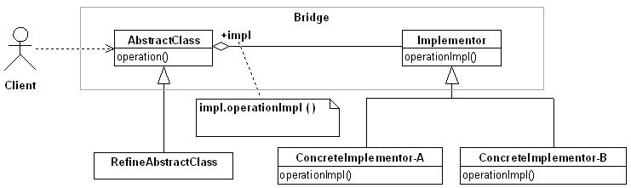
Bridge (cont’d)

Slide 65
Bridge (cont’d)
Consequences.
The decoupling of the implementations from the abstract classes that use them increases extensibility.
The Bridge pattern allows the abstraction and the implementation to vary independently of each other.
Clients are not aware of implementation issues.

Slide 66
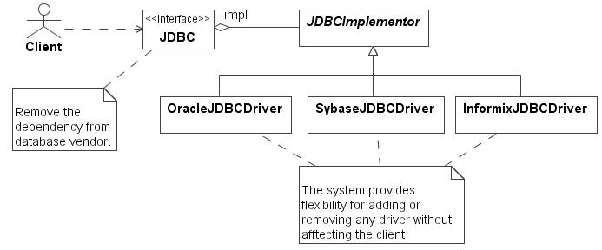
Bridge (cont’d)
Example: Abstracting database vendors.

Slide 67
Decorator
Intent.
Attach additional responsibilities to an object dynamically.
Problem.
You may need to add some additional functionality to individual object dynamically and transparently without affecting other object and possibly to withdraw the extended functionality.
Solution.
During extending the functionality of an object without resorting to subclass.

Slide 68
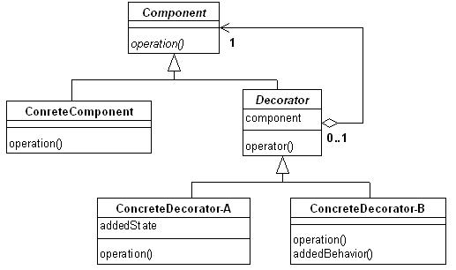
Decorator (cont’d)

Slide 69
Decorator (cont’d)
Consequences.
The Decorator pattern provides more flexibility than inheritance.
The Decorator pattern provides different kinds of functionality via the ConcretDecorator to create new objects.
Example: Composing a TextView object with BorderDecorator and ScrollDecorator.
aTextView ; aScrollBarDecorator
⇒ a scrollable text view + aBorderDecorator
⇒ a scrollable and bordered text view
where “;” means “compose”, “⇒” means “produce”, “+” means add.

Slide 70
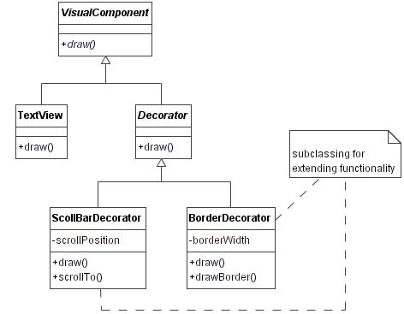
Decorator (cont’d)
Example: A composition of TextView, ScrollBarDecorator, and BorderDecorator ^{(*)}.
(*) [GoF 1995].

Slide 71
Composite
Intent.
Compose objects into tree structures to represent whole-part hierarchies [GoF 1995].
Problem.
To decompose a complex object into a whole-part hierarchy of objects.
Clients are able to ignore the difference between compositions of objects and individual object, that is, object in the composite will be treated uniformly.

Slide 72
Composite (cont’d)
Solution.
Providing an abstract superclass for all objects in hierarchy and an abstract superclass for all composites in the hierarchy to minimize the complexity of a composite object organized into whole-part hierarchies.

Slide 73
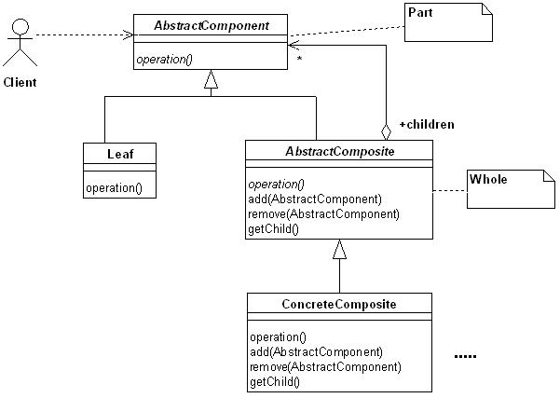
Composite (cont’d)

Slide 74
Composite (cont’d)
Consequences [GoF 1995].
Define class hierarchies consisting of composite objects and primitive objects that can be composed into more complex objects, which in turn can be composed on recursively.
Make the client simple.
Make it easier to add new kinds of components
Can make design overly general. Thus, making it easy to add new components is that makes it harder to restrict the components of a composite.

Slide 75
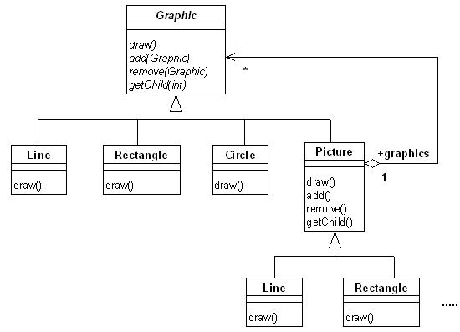
Composite (cont’d)
Example: A graphics application ^{(*)}.
(*) Redrawn from {GoF 1995].

Slide 76
Proxy
Intent.
Provide a lightweight class that makes it unnecessary to always have to deal with a heavyweight class [Lethbridge et al. 2001].
A class is heavyweight when it is time-consuming and complicated to create instances of the class, for instance, instances of a heavyweight class might always reside in a database or a server.
Problem.
How to reduce the need to create instances of a heavyweight class?

Slide 77
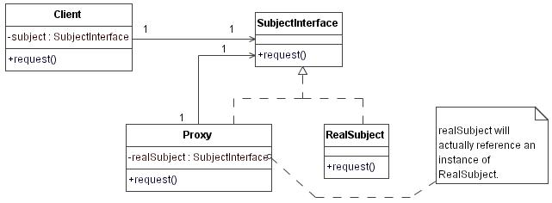
Proxy (cont’d)
Solution.
Create a simpler version of the heavyweight class (RealSubject in [GoF 1995]) called Proxy. The Proxy has the same interface as the heavyweight class. So, programmers need not to care whether a Proxy or its heavyweight version will be put in the variable.

Slide 78
Proxy (cont’d)
Consequences.
The Proxy pattern introduces a level of indirection when clients access an object.
The kind of proxy:
Remote proxy: an object resides in a different address.
Virtual proxy: creating an object on demand while partial information about the component is sufficient.
Protection proxy: component must be protected from unauthorized access.

Slide 79
5.3.5 Behavior Patterns
Chain of Responsibility
Strategy
Observer
Template

Slide 80
Chain of Responsibility
Intent.
A client sends a request without knowing what object or objects will receive it. It accomplishes that by passing the request to a chain of objects. Each object in the chain may handle the request and pass the request on to the next object in the chain.
Problem.
You want to issue a request to one of several objects without specifying the receiver explicitly. What to do?

Slide 81
Chain of Responsibility (cont’d)
Solution.
Let a client send a request to a handler that is actually part of a chain of handlers, and either handles the request directly, or passes on the request to its successor. This delegation continues until a handler that takes responsibility for the request.

Slide 82
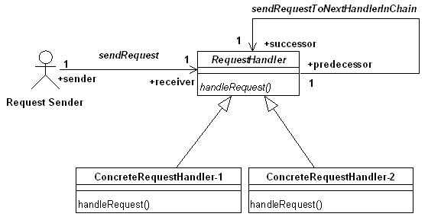
Chain of Responsibility (cont’d)

Slide 83
Chain of Responsibility (cont’d)
Consequences.
This pattern frees an object (request sender) from knowing which other object handles the request so that the coupling between request sender and request handler is reduced.
Both sender and receiver have no knowledge of each other, and object in the chain doesn’t have to know about the chain’s structure.
The pattern can simplify object interconnections.
Assign responsibilities to objects is flexible.
No guarantee that the request will be handled if the chain is not configured properly.

Slide 84
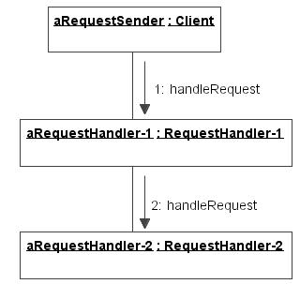
Chain of Responsibility (cont’d)
Note: The GoF describes the dynamic semantics of this pattern by collaboration diagram.

Slide 85
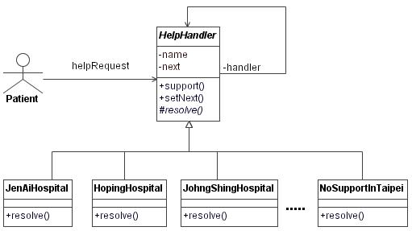
Chain of Responsibility (cont’d)
Example: A patient comes to hospital. Who will resolves the trouble if there is a life-threatening situation?

Slide 86
Strategy
Intent.
Encapsulate related algorithms or business rules in classes that are subclasses of a common superclass, and let the algorithm vary independently form clients that use it.
Problem.
How to design for varying, but related algorithms or business rules.
How to design for the ability to change these algorithms or business rules without affecting the others.

Slide 87
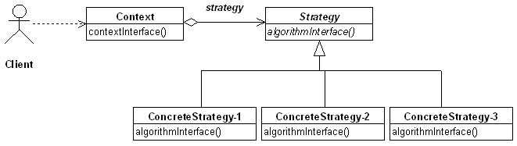
Strategy (cont’d)
Solution.
Define each algorithm or business rule in a separate class, with a common interface.

Slide 88
Strategy (cont’d)
Consequences.
Switch and/or if statement can be eliminated for the code of client.
All algorithms must invoke in the same way, that is, they must have the same interface.
The responsibility of selecting the particular implementation to use is done by the Client object and is given to the Context object of the pattern, that is, the Context forwards requests from its client to Strategy.

Slide 89
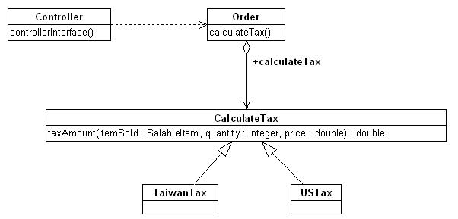
Strategy (cont’d)
Example: An order processing system for international e-commerce ^{(*)}.
(*) [Shalloway et al. 2005].

Slide 90
Observer ^{(*)}
Intent.
Define a one-to-many dependency between objects so that when one object (Subject or Publisher) changes state, all its dependencies (Observer or Subscriber) are notified and updated automatically.
Problem.
The observers want to react in their own unique way when the subject generates an event. The subject wants to maintain low coupling to the observers. What to do?
(*) Also called Publish-Subscribe pattern.

Slide 91
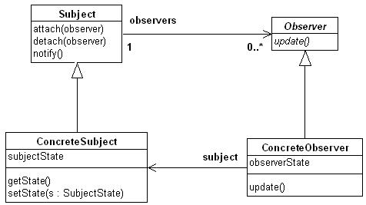
Observer (cont’d)
Solution.
Define a observer or listener interface. Observers implement this interface. The subject can dynamically register observers who are interested in an event, and notify them when an event occurs.
Notes:
Note
attach (observer) : adds the given observer to its list of observers.
detach (observer): removes the given observer from its list of observers.
The Subject implements a notify operation that goes through its list of Observers and calls this update operation for each of them.
If notifying each Observer is not enough to get more information, you may add operation(s) to the Subject that allow the Observers to get whatever information they need.
Each Observer calls getState for information on the newly added Subject to see what it needs to do.

Slide 92
Observer (cont’d)
Consequences.
Observer has greater value if the list of objects (registered in Subject) need to be notified of an event changes or somehow conditional. These changes can occur either because the requirements changes or because the list of objects that need to be notified are changed.
The system can run under different conditions or by different subjects, each having a different list of required observers.
An observer may filter out some extra notifications if it may only need to handle certain cases of an event.

Slide 93
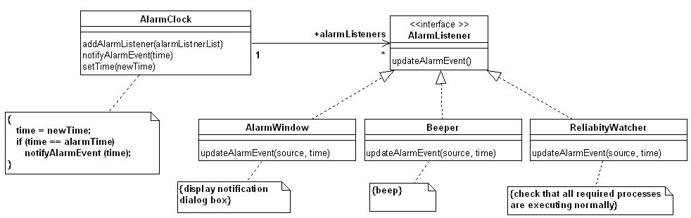
Observer (cont’d)
Example: An alarm broadcasting ^{(*)}.
(*) An example redrawn from [Larman 2002].

Slide 94
Case Exercise
The headquarter of an international marketing company maintains database of its sales data of foreign subsidiaries on a server which are updated instantly.
The status report on headquarter users’ computer display need to be refreshed automatically in different time interval according to its needs. Suppose the Senior Manager’s bar chart is updated after 5% change has taken place, Marketing is shown a new pie chart when a change of at least 1% takes place, and Operations’ display are updated whenever any change takes place.
How can you design a software architecture to fulfill these requirements?

Slide 95
Template Method
Intent.
Define the skeleton of an algorithm in an operation, deferring some steps to subclass. Redefine the steps in an algorithm without changing the algorithm’s structure [GoF 1995].
Problem.
There is a procedure of a set of steps to follow that defines the skeleton of an algorithm at higher level, but individual steps may have different implementations at a lower level.

Slide 96
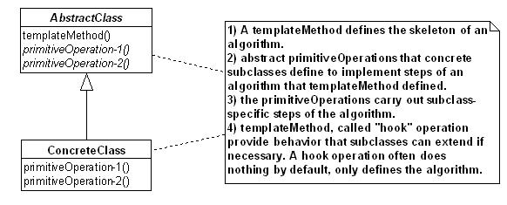
Template Method (cont’d)
Solution.
Define a method (the Template Method) in a superclass that defines the skeleton of an algorithm, and let the abstract methods in the superclass implemented in the subclass.

Slide 97
Template Method (cont’d)
Consequences.
Template methods are a fundamental technique for code reuse, and are helpful in ensuring the required steps are implemented.
Template methods bind the overridden steps together for each Concrete class.
The Template Method pattern forms the basis of all patterns dealing with abstract classes. It is the heart of framework design.

Slide 98
Template Method (cont’d)
The following kinds of methods have to be distinguished in the implementation of frameworks ^{(*)}:
template methods which are based on
hook methods, which are either
abstract methods,
regular methods, or
template methods.
Note that a regular method provides a meaningful implementation without calling other methods.
(*) Wolfgan Pree, Design Patterns for Object-Oriented Software Development, Addison-Wesley, 1994.

Slide 99
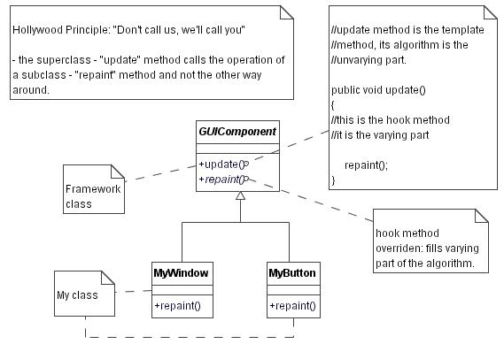
Template Method (cont’d)
Example 1: A GUI framework [Larman 2002].

Slide 100
Template Method (cont’d)
Example 2: An example of the e-commerce, by which the Template Method pattern can be easily understood ^{(*)}.
Query process on databases:
Open database with database command: CONNECT;
Perform query using database command: SELECT;
Return dataset.
(*) This example is extracted from [Shalloway et al. 2005].

Slide 101
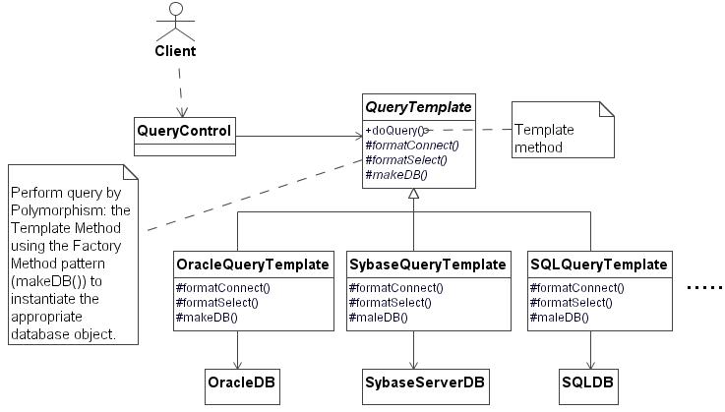
Template Method (cont’d)
Using the Template Method (doQuery()) and Factory Method (makeDB()) to perform a query .
Note: Lecturers may explain how doQuery method is implemented.

Slide 102
5.3.6 Compound Design Patterns
Compound design patterns are the core abstractions from recurring framework, while software design patterns are the core abstractions from recurring problem solution in software design [Riehle 1997] ^{(*)}.
A compound design pattern is a pattern that tightly integrates two or more design patterns.
A compound design pattern is composed of some atomic or composite patterns and shows a synergy of the composition more than the sum of its parts.
(*) Riehle called “compound design pattern” as “composite design pattern”.

Slide 103
Compound Design Patterns (cont’d)
Example 1 [Riehle 1997]: MVC pattern collaborates three objects: a Model object, a View object, and a Controller object. These objects interact according to the Observer, Strategy and Composite patterns, thus MVC is composed of those design patterns.
A View observes a Model: the View is an Observer of the Model which is its Subject (see [GoF 1995]) and does not handle user input but leaves this to the Controller.
A Controller is a Strategy for handling user input.
Views can have Subviews representing parts of user interface (such as this PowerPoint view), so View is a Component in the Composite pattern and different Views can be either Leafs or Composites.

Slide 104
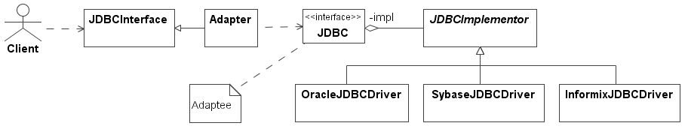
Compound Design Patterns (cont’d)
Example 2: Suppose you want to use the JDBC driver provided by Oracle, Sybase, or Informix (see Bridge pattern) for your application development. You find that the interface these database vendor provided is different from what you need. In this case, you may integrate the Adapter pattern with Bridge pattern as follows:

Slide 105
Compound Design Patterns (cont’d)
Example 3: An interesting example given by Riehle is the Active Bridge pattern [Riehle 1997] which represents a recurring type of framework connected an application to underlying event-driven resources, such as window-system widgets.
The Active Bridge pattern is a composition of five patterns: Bridge, Proxy, Observer, Abstract Factory, and Factory Method, shown as follows (next slide):

Slide 106
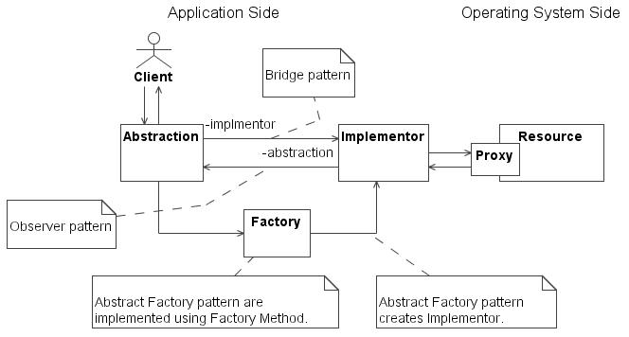
Compound Design Patterns (cont’d)

Slide 107
Exercises
To find other papers that discuss different aspects for classifying GoF’s design patterns.
Why do we need a “Client” in the structure of the design patterns?
Compare the Creation versus Instantiation.
Classify the Structural Patterns by class/ object level.
What is the frequently used relations in structure patterns
Does Association be used in structure patterns? Why ?
In the design phase, we need more detail description to describe our diagram, but the association is too abstractly to be used.
Compare adapter and composite patterns.

Slide 108
Exercises
Compare the responsibility and service.
Discuss the encapsulating variation of behavioral pattern.
Discuss the advantage and disadvantage for Strategy and Command patterns.
Discuss the implementation issue of Observer pattern.
Using three architecture patterns to design a system which you familiar.
Using three design patterns to design a system which you are familiar.

